Slide 1
RTC on the Teensy 3.6
WEA
2017-12-15

Slide 2
Summary
Goal:
Make RTC work on the Teensy so that Tympan users can maybe log time-based data across many different use sessions
Problem:
The Teensy looses the time whenever power is cut to the Teensy (such as via the power switch)
Solution Approach:
Design a connection directly from the LiPo battery to power just the Teensy’s RTC
Result:
Used a voltage divider (50K/125K). Installed on a Tympan Rev A
Used the Teensy Time library (I didn’t have to write any code!)
It works!
This doc:
Shows the mods that I did. Discusses how the RTC works. Shows calcs for resistor divider.

Slide 3
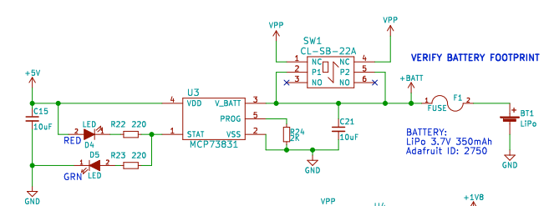
Connect to LiPo Somewhere between the Battery and the Power Switch
Grab V_{LiPo} Between Battery and Switch
Grab Ground Anywhere on the PCB

Slide 4

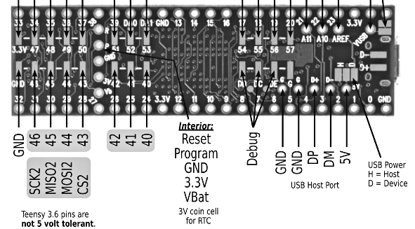


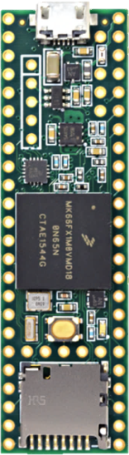

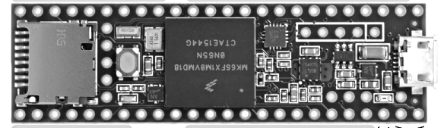

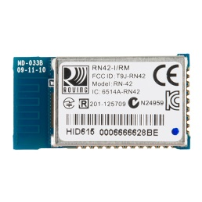
Add Voltage Divider from LiPo to Supply RTC VBat
View from Below Teensy
J2
J1
D7
D6
U2
Mic
R
Mic
L
Connect to underside of board?
View from Above Teensy
OFF
U23
Vbat
U24
J6
+
R1
ON
Gnd
R2
IN3
L
R1=50K
R2=125K
Line-O
R
L
G
+
R
J5
TP2 is also Gnd,
If you prefer
R19
D11
D10
D5
CoolAid, 2017-12-15, WEA
TYMPAN

Slide 5
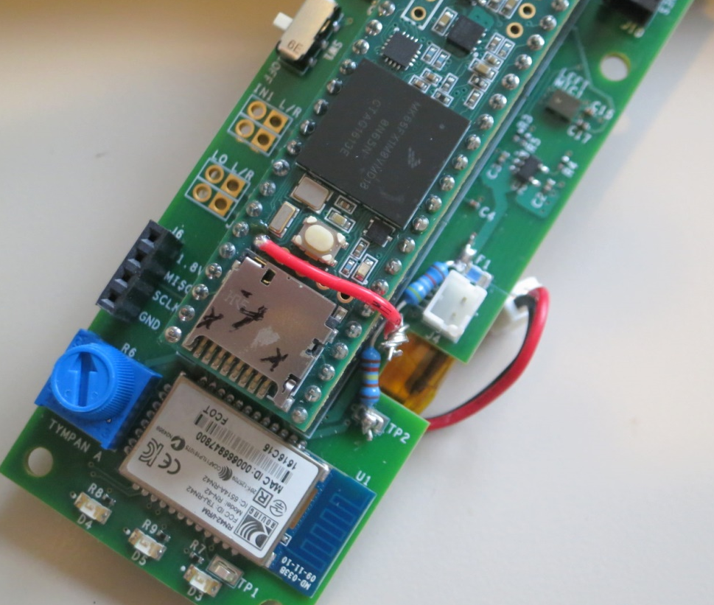
J2
J1
D7
D6
U2
RTC VBat
Hole
Mic
R
U23
Mic
L
LiPo
Via F1
Battery +
(on F1)
OFF
U24
ON
R1 = 50K
IN3
L
50K
RTC VBat
On Teensy
Line-O
R
L
G
+
R
J5
125K
R2 = 125K
Gnd
Via TP2
R19
Ground
(on TP2)
D11
D10
D5
TYMPAN

Slide 6

Modification to Tympan Rev A
RTC Vbat
Hole
Battery +
(on F1)
R1 = 50K
R2 = 125K
Ground
(on TP2)

Slide 7
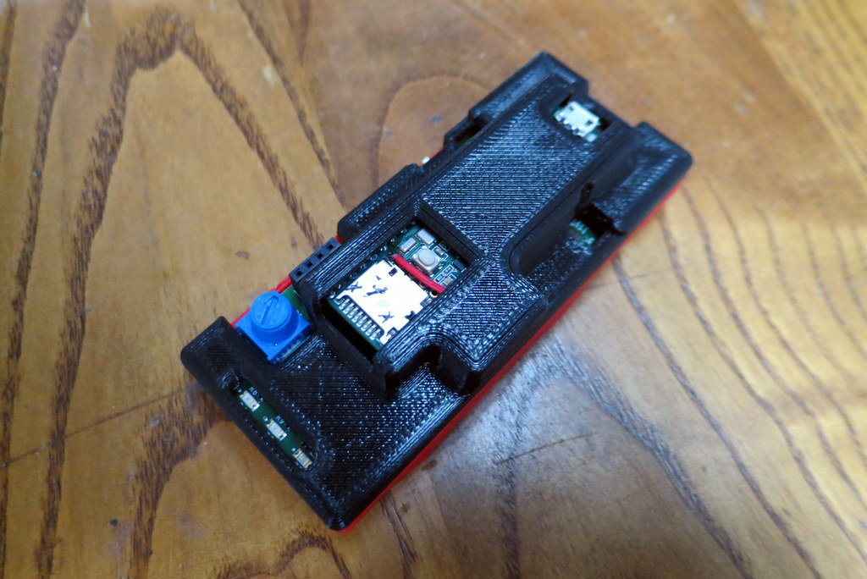
Fits in Enclosure!

Slide 8
Testing – It works!
Used Teensy Example “TimeTeensy3” from the Time library that can be installed with Teensyduino
Using an unmodified Teensy, time keeps getting lost
Time is kept correctly until you turn off the Tympan power switch. When you turn it back on, time is reset back to the beginning.
Using my modified Teensy, time is kept correctly
Correct time is maintained despite turning power switch off/on
Correct time is maintained despite plugging/unplugging from USB

Slide 9
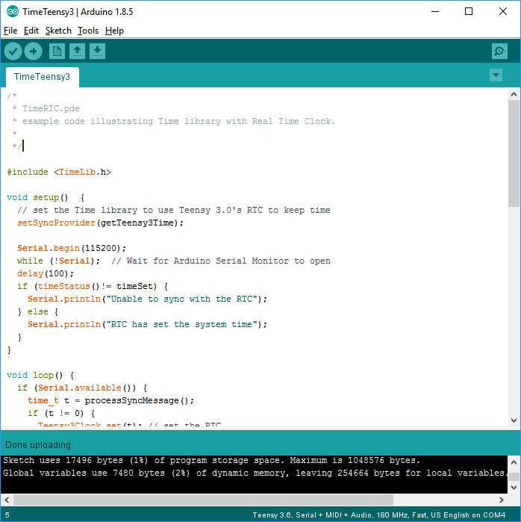

Slide 10
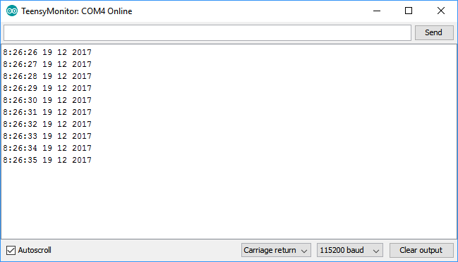

Slide 11
How RTC on the Teensy Works
Teensy 3.6 has an oscillator and counter that keep running, as long power is applied to Vbat
Upon first power up, it starts counting from zero
If you know what time it was at count = zero, then you know what time it is now.
As long as power to Vbat is maintained, it keeps a continuous count.
Vbat is internally connected to the main power supply so that, whenever the Teensy itself is powered, the RTC counts correctly
The trick is what happens when power is removed from the Teensy. Normally it would lose count.
Typically, one wires a coin cell to the RTC’s Vbat to supply power when the Teensy itself is unpowered
As long as the coin cell keeps its voltage, the RTC never loses count. Time is maintained.
Instead, we have wired in our LiPo Battery instead.
To access the RTC count, the Teensy folks wrote a Time library
It takes care of all the back-end how to access and interpret the RTC_count
It presents a human-readable date/time to the user based on some reference time that corresponds to RTC_Count = zero.
Where does the Time library get the reference time/date?
When the Teensy sketch is compiled, the compiling of the Time library poles the PC’s current time/date
This value is tored in the Flash on the Teensy. This becomes the reference time for the RTC count = zero.
Key implications:
If power is maintained to Vbat, the RTC counter keeps accumulating and time is correct
If power is lost to Vbat, the count is lost. When power is re-applied, the counter restarts. Since it thinks that counter = zero is the reference time stored in flash, the user is told the wrong time/date.
Unknowns:
It is unclear to me whether the system *knows* if power has been lost or not. This seems like an important thing to be aware of. More experimentation is needed.

Slide 12
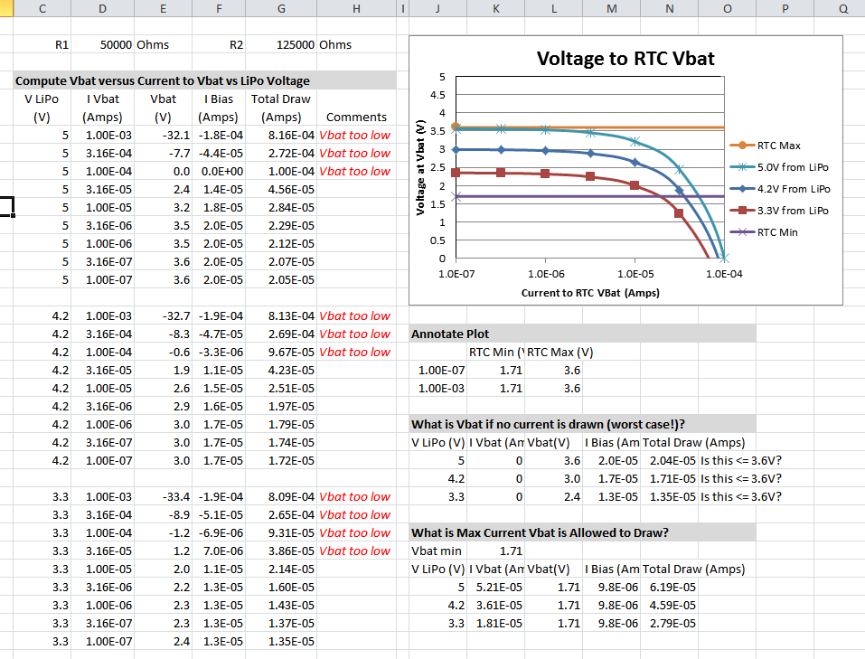
Voltage Divider Calcs
Resistor
Values
Vbat is low enough. Good.
Available current to RTC is up to 0.028 mA.
Hopefully this is good enough
See Discussion on Teensy Forum: https://forum.pjrc.com/threads/48417-Voltage-limit-on-Teensy-3-6-for-RTC-Vbat

Slide 13
